Slide 1

Forecasting Using Time Series
Project-12

Slide 2
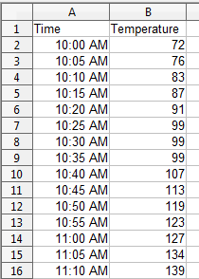
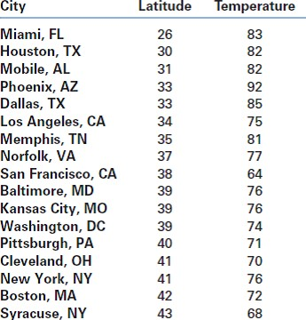
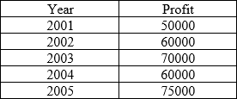


Time Series and Forecasting
A time series is a series of data points indexed (or listed or graphed) in time
order.
Time Series
Stamatics

Slide 3
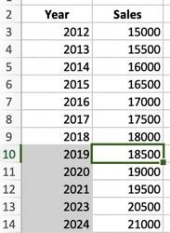
Time Series and Forecasting
Time series forecasting is the use of a model to predict future values based
on previously observed values
Time Series Forecasting
Stamatics

Slide 4


Forecasting Application
Retail Industry
Stamatics

Slide 5
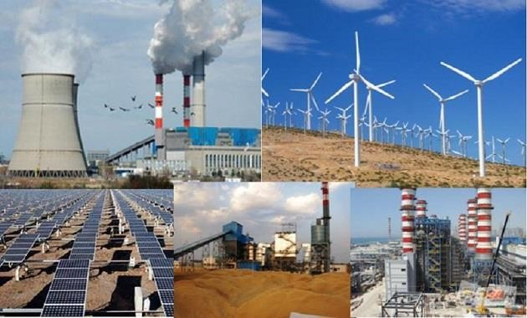
Forecasting Application
Energy Industry
Stamatics

Slide 6

Forecasting Application
Government
Stamatics

Slide 7

Forecasting Application
Financial Organization
Stamatics

Slide 8

Forecasting Application
Agriculture
Stamatics

Slide 9
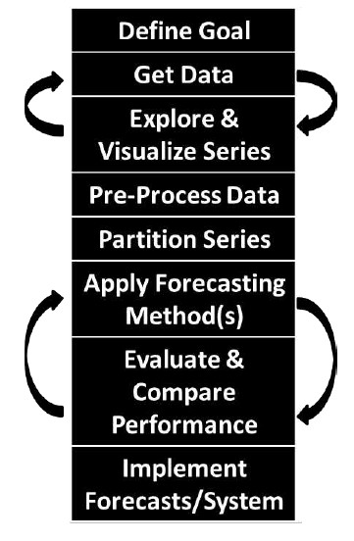
Forecasting Process
Steps
Stamatics

Slide 10
Forecasting Process
One must first determine
The purpose of generating forecasts,
The type of forecasts that are needed,
How the forecasts will be used by the organization,
What are the costs associated with forecast errors,
What data will be available in the future, and more
Goal Definition

Slide 11
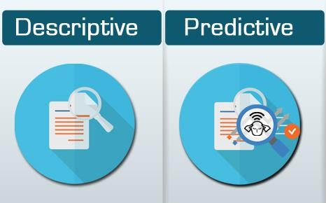
Forecasting Process
Goal Definition
Stamatics

Slide 12
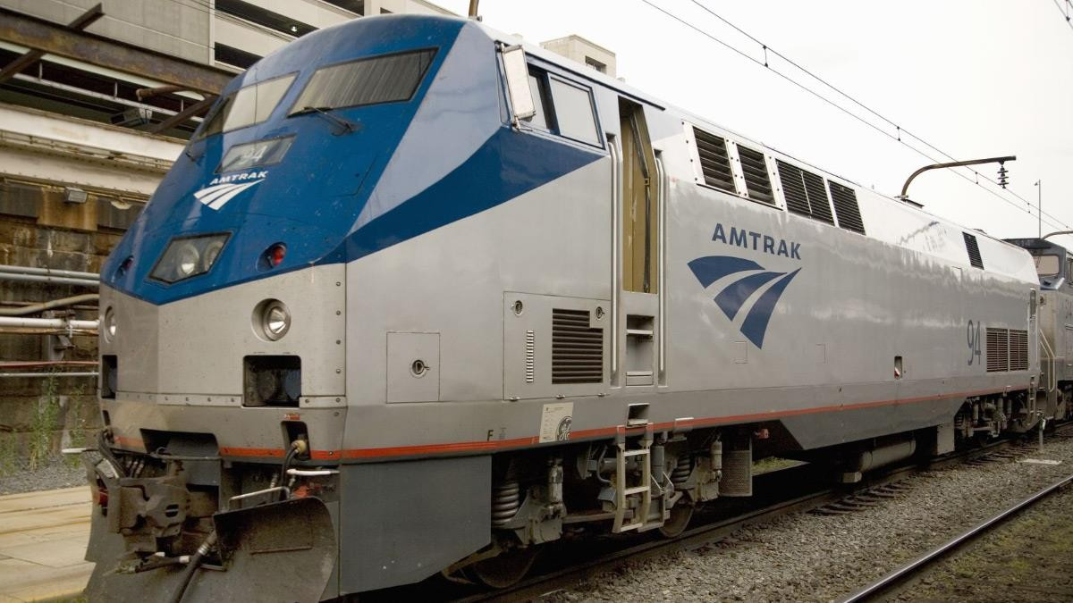
Forecasting Process
Goal Definition Example
AMTRAK –US Railway company Ridership Data
From Jan 1991 to March 2004
Stamatics

Slide 13

Forecasting Process
AMTRAK
Goal Definition Example
Evaluating the effect of some event, such as airport closures due to inclement weather, or the opening of a new large national highway. This goal is retrospective in nature, and is therefore descriptive or even explanatory.
Amtrak might have is to forecast future monthly ridership on its trains for purposes of pricing.
Using demand data to determine pricing is called "revenue management" and is a popular practice by airlines and hotel chains
Stamatics

Slide 14
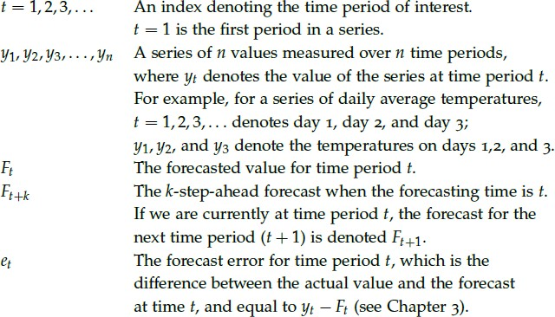
Forecasting Horizon
Basic Notation

Slide 15
Forecasting Horizon
The forecast horizon k is the number of periods ahead that we must forecast, and 𝐹_{𝑡+𝑘} is a k-step-ahead forecast.
Forecasting Horizon
In the Amtrak ridership example, one-month-ahead forecasts (𝐹_{𝑡+1}) might be sufficient for revenue management (for creating flexible pricing), whereas longer term forecasts, such as three-month ahead (𝐹_{𝑡+3}), are more likely to be needed for scheduling and procurement purposes.

Slide 16
Forecasting
It is important to understand how the forecasts will be used
Over-prediction vs under-prediction
Presented to management or to the technical department
Forecasts be used directly or will they be "adjusted" in some way before use
Should forecasts be numerical or binary ("event"/"non-event“)
Forecasting Use and Automation
Automation requirement
How many series need to be forecasted?
Is the forecasting an ongoing process or a one time event?
Which data and software will be available during the forecasting period?
4. What forecasting expertise will be available at the organization during
the forecasting period?

Slide 17
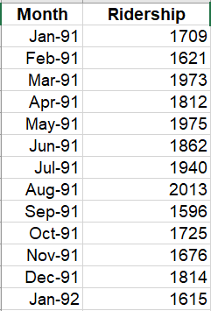
Visualizing Time Series
The most basic and informative plot for visualizing a time series is the time plot.
it is a line chart of the series values (y1, y2, . . .) over time (t = 1, 2, . . .), with temporal labels (e.g., calendar date) on the horizontal axis
Ridership (Number of Passengers in thousands)
2400
2200
2000
Time Plot
1800
1600
1400
1200
1000
Jan-91
Jul-91 Jan-92 Jul-92 Jan-93 Jul-93 Jan-94 Jul-94 Jan-95 Jul-95 Jan-96 Jul-96 Jan-97 Jul-97 Jan-98 Jul-98 Jan-99 Jul-99 Jan-00 Jul-00 Jan-01 Jul-01 Jan-02 Jul-02 Jan-03 Jul-03 Jan-04

Slide 18
Visualizing Time Series
Zooming in to a shorter period within the series can reveal patterns that are hidden when viewing the entire series. This is especially important when the time series is long.
Ridership (Number of Passengers in thousands)
Ridership (Number of Passengers in thousands)
2400
2400
2200
2200
2000
2000
Zooming in
1800
1800
1600
1600
1400
1400
1200
1200
1000
1000
Jan-96
Feb-96 Mar-96 Apr-96 May-96 Jun-96 Jul-96 Aug-96 Sep-96 Oct-96 Nov-96 Dec-96 Jan-97 Feb-97 Mar-97 Apr-97 May-97 Jun-97 Jul-97 Aug-97 Sep-97 Oct-97 Nov-97 Dec-97
Jan-91
Oct-91 Jul-92 Apr-93 Jan-94 Oct-94 Jul-95 Apr-96 Jan-97 Oct-97 Jul-98 Apr-99 Jan-00 Oct-00 Jul-01 Apr-02 Jan-03 Oct-03

Slide 19
Visualizing Time Series
Another possibility for better capturing the shape of the trend is to add a trend line
By trying different trend lines one can see what type of trend (e.g., linear, exponential, cubic) best approximates the data.
Ridership (Number of Passengers in thousands)
Polynomial Trend Line
2400
2400
2200
2200
Adding Trend Lines
2000
2000
1800
1800
1600
1600
1400
1400
1200
1200
1000
1000
Jan-91
Sep-91 May-92 Jan-93 Sep-93 May-94 Jan-95 Sep-95 May-96 Jan-97 Sep-97 May-98 Jan-99 Sep-99 May-00 Jan-01 Sep-01 May-02 Jan-03 Sep-03
Jan-91
Aug-91
Mar-92 Oct-92 May-93 Dec-93 Jul-94 Feb-95 Sep-95 Apr-96 Nov-96 Jun-97 Jan-98 Aug-98 Mar-99 Oct-99 May-00 Dec-00 Jul-01 Feb-02 Sep-02 Apr-03 Nov-03

Slide 20
Visualizing Time Series
It is often easier to see trends in the data when seasonality is suppressed.
Suppressing seasonal patterns can be done by plotting the series at a cruder time scale
Ridership (Number of Passengers in thousands)
Total
2400
27000
2200
25000
Suppressing Seasonality
2000
23000
1800
21000
1600
1400
19000
1200
17000
1000
15000
Jan-91
Sep-91 May-92 Jan-93 Sep-93 May-94 Jan-95 Sep-95 May-96 Jan-97 Sep-97 May-98 Jan-99 Sep-99 May-00 Jan-01 Sep-01 May-02 Jan-03 Sep-03
1991 1992 1993 1994 1995 1996 1997 1998 1999 2000 2001 2002 2003

Slide 21
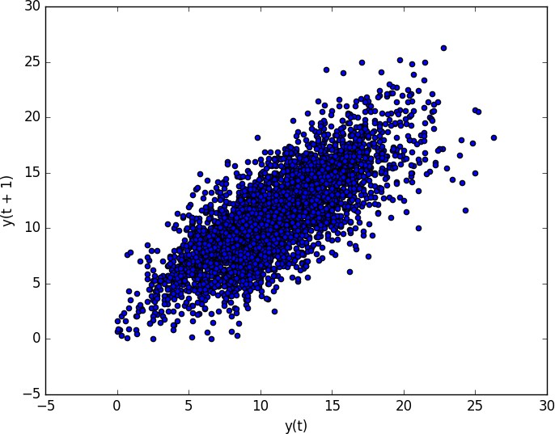
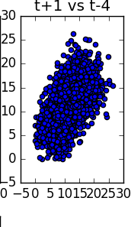
Visualizing Time Series
Time series modeling assumes a relationship between an observation and the previous observation.
Previous observations in a time series are called lags. A useful type of plot
to explore the relationship between each observation and a lag of that observation is called the scatter plot.
Lag Scatter Plot

Slide 22
Time Series – Feature Engineering
What is Feature Engineering
The rationale and goals of feature engineering time series data.
What we will learn
How to develop basic date-time based input features.
How to develop more sophisticated lag and sliding window summary
statistics features.

Slide 23
Time Series – Feature Engineering
A time series dataset must be transformed to be modeled as a supervised learning problem.
time 1 | value 1
time 2 | value 2
time 3 | value 3
input 1 | output 1
input 2 | output 2
input 3 | output 3
Basics
Input variables are also called features in the field of machine learning, and the task before us is to create or invent new input features from our time series dataset.

Slide 24
Time Series – Feature Engineering
Date Time Features: these are components of the time step itself for each observation.
Lag Features: these are values at prior time steps.
Window Features: these are a summary of values over a fixed window of prior time steps.
Types of Feature
Date | Footfall
10 Jan 20 | 853
11 Jan 20 | 1376
12 Jan 20 | 1289
13 Jan 20 | 657
Weekend | Footfall 7 d ago | Last 7 Day avg
0 | 785 | 985
1 | 1456 | 972
1 | 1145 | 995
0 | 764 | 970

Slide 25
Time Series – Feature Engineering
Rolling window: add a summary of the values at previous time Steps
Expanding Window: Another type of window that may be useful includes all previous data in the series.
Window Features
Date | Footfall
10 Jan 20 | 853
11 Jan 20 | 1376
12 Jan 20 | 1289
13 Jan 20 | 657
Last 7 Day avg | Maximum till date
985 | 1195
972 | 1195
995 | 1376
970 | 1376

Slide 26
Time Series – Resampling
Resampling – Changing frequency of available data to match the frequency of required forecast
Types
Resampling
Upsampling
Downsampling

Slide 27
Resampling
Upsampling – Where you increase the frequency of the samples, such as
from minutes to seconds.
Month | Footfall
1 | 240
2 | 260
3 | 353
4 | 433
5 | 467
6 | 476
7 | 500
8 | 450
9 | 339
10 | 140
11 | 217
12 | 300
Upsampling
Quarter | Footfall
Quarter 1 | 853
Quarter 2 | 1376
Quarter 3 | 1289
Quarter 4 | 657

Slide 28
Resampling
Downsampling – Where you decrease the frequency of the samples, such
as from days to months.
Quarter | Footfall
Y 1 – Q1 | 240
Y 1 – Q2 | 260
Y 1 – Q3 | 353
Y 1 – Q4 | 433
Y 2 – Q1 | 467
Y 2 – Q2 | 476
Y 2 – Q3 | 500
Y 2 – Q4 | 450
Y 3 – Q1 | 339
Y 3 – Q2 | 140
Y 3 – Q3 | 217
Y 3 – Q4 | 300
Downsampling
Quarter | Footfall
Year 1 | 1286
Year 2 | 1793
Year 3 | 1289

Slide 29
Power Transformation
To better identify the shape of a trend, it is useful to change the scale of the series
Ridership (Number of Passengers in thousands)
14000
12000
10000
Changing the Scale
8000
6000
4000
2000
0
Jan-91
Mar-91 May-91
Jul-91 Sep-91
Nov-91 Jan-92
Mar-92 May-92 Jul-92
Sep-92 Nov-92
Jan-93 Mar-93 May-93
Jul-93 Sep-93 Nov-93
Jan-94
Mar-94
May-94 Jul-94 Sep-94 Nov-94 Jan-95 Mar-95 May-95 Jul-95 Sep-95 Nov-95 Jan-96 Mar-96 May-96 Jul-96 Sep-96 Nov-96

Slide 30
Power Transformation
To better identify the shape of a trend, it is useful to change the scale of the series
If the trend on the new scale appears more linear, then the trend in the original series is closer to an new function trend.
Ridership (Number of Passengers in thousands)
Log Ridership (Number of Passengers in thousands)
14000
12000
1000
900
800
700
600
500
400
300 200
100
0
Changing the Scale
10000
8000
6000
4000
2000
0
Jan-91
May-91
Sep-91
Jan-92
May-92
Sep-92
Jan-93
May-93
Sep-93
Jan-94
May-94
Sep-94
Jan-95
May-95
Sep-95
Jan-96
May-96
Sep-96
Jan-91
May-91
Sep-91
Jan-92
May-92
Sep-92
Jan-93
May-93
Sep-93
Jan-94
May-94
Sep-94
Jan-95
May-95
Sep-95
Jan-96
May-96
Sep-96

Slide 31
Time Series – Moving Average
What we will cover
Moving Average Smoothening
What is moving average smoothening? Why?
Centered Window vs Trailing Window MA
Feature engineering and forecasting using MA

Slide 32
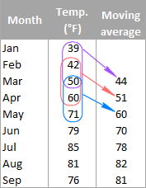
Time Series – Moving Average
MA smoothening is creating a new series where values are averages of the raw observations
Moving Average Smoothening

Slide 33
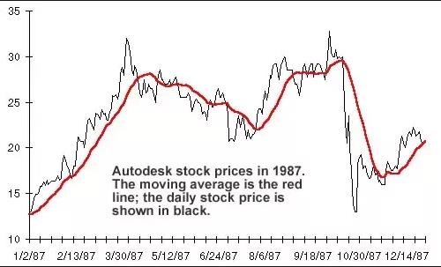
Time Series – Moving Average
Moving Average Smoothening

Slide 34


Time Series – Moving Average
MA smoothening is creating a new series where values are averages of the
raw observations
Window width
Moving Average Smoothening
Trailing
Centered

Slide 35
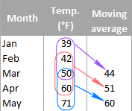
Time Series – Moving Average
Trailing MA can be used in 2 ways
1. Feature Engineering
Moving Average Smoothening
2. Forecasting
Forecating for month of June can be 60, which is trailing MA for previous 3 months

Slide 36
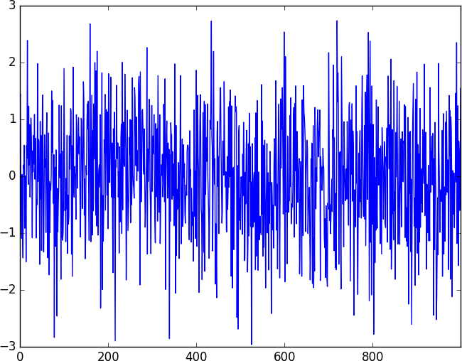
Time Series – White Noise
White noise is a sequence of random numbers
White Noise

Slide 37
Time Series – White Noise
To identify whether the series to be forecasted is white noise or not
The error values of our predictions are white noise or not
White Noise Why?
Summary
Series should not be white noise
Error values should be white noise

Slide 38
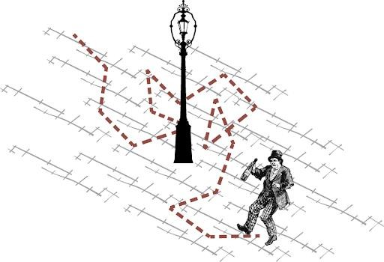
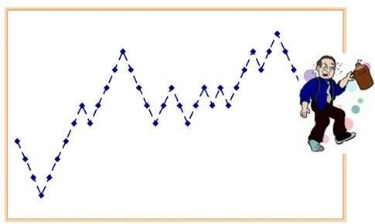
Time Series – Random Walk
Next value of the series is the modification of the previous value in the sequence
Random Walk

Slide 39
Time Series – Random Walk
Random Walk
In the case of Random Walk, naïve forecasting gives the best result

Slide 40
Time Series – Smoothing
Moving Average smoothing
Simple averaging
Exponential smoothing weighted averaging
Simple exponential smoothing
Smoothing constant

Slide 41
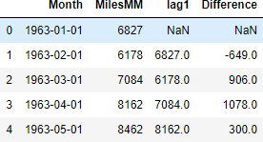
Time Series – Differencing
Differencing is a method for removing trend and seasonality
1. Lag 1 Differencing
^{𝑌}𝑡 ^{− 𝑌}𝑡−1
Removing trend and seasonality
2. Lag k Differencing
^{𝑌}𝑡 ^{− 𝑌}𝑡−𝑘

Slide 42
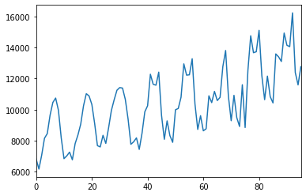
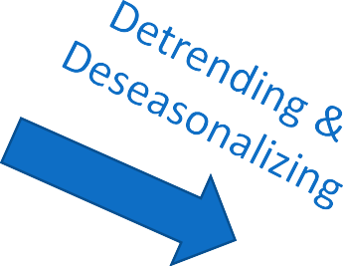

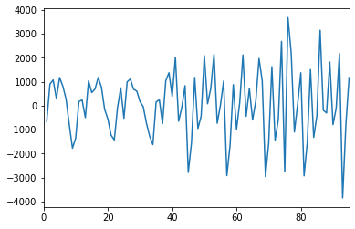
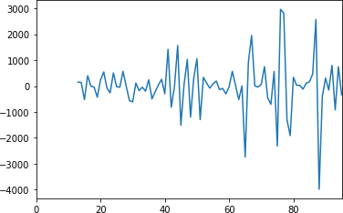
Time Series – Differencing
Deseasonalizing

Slide 43
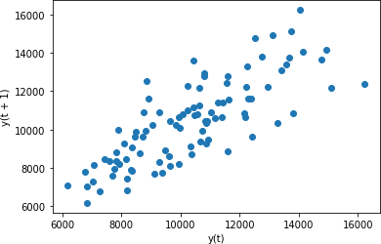
Time Series – Auto regression model
Use only on series without trend and seasonality
Auto regression
Simple regression model
𝑌෠
= 𝐵₀ + 𝐵₁ × 𝑋₁

Slide 44
Time Series – Auto regression model
_{𝑌}෠
= 𝐵₀ + 𝐵₁ × 𝑋₁
Step 1
Feed a set of X and Y values to the model
Step 2
Model tries to fit a straight line on the given values. Finds value of B0 and B1 by minimizing total error
Step 3
Use B0 and B1 values to predict future values of Y
Steps
Fore auto regression model – lag values of same variable are used as input values

Slide 45
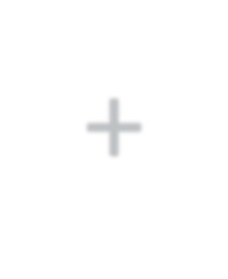


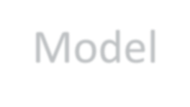


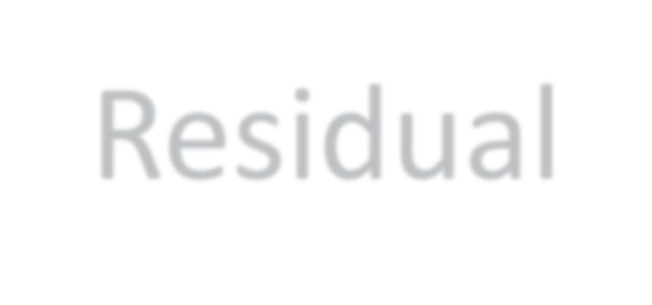

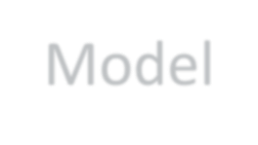
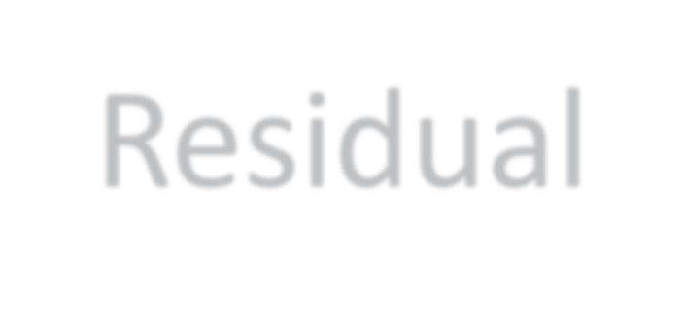
Time Series – Moving Average model
It is different from moving average smoothing method
Input 𝑌෠ + Residual
Model
Moving Average
Forecasted Residual
Residual
Model

Slide 46
Time Series – Moving Average model
Step 1
Build a forecasting model (AR or Persistence model)
Step 2
Find residual/ Forecast errors
Step 3
Build a forecast model on residuals
Step 4
Use forecasted residuals to update the initial forecast
Steps
If initial forecasting model is AR this technique is also called ARMA

Slide 47
Time Series – ACF and PACF
1. Correlation-
Relation between 2 variables. Measured by Pearson’s Correlation Coef.
Coef. Value | Relationship | Inference
+1 | Positive | If x increases, y also increases
-1 | Negative | If x increases, y decreases
0 | No Relationship | If x increases, no effect on y
ACF and PACF
For time series analysis, instead of 2 different variables, X is lagged value of y
So, therefore it is called AutoCorrelation => Correlation with itself

Slide 48
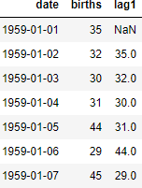
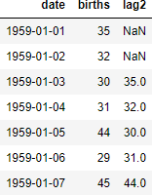
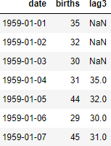
Time Series – ACF and PACF
Lag 1 Lag 2
Lag 3
ACF and PACF
Correlation
Coef = 0.8
Correlation
Coef = 0.6
Correlation
Coef = 0.4

Slide 49
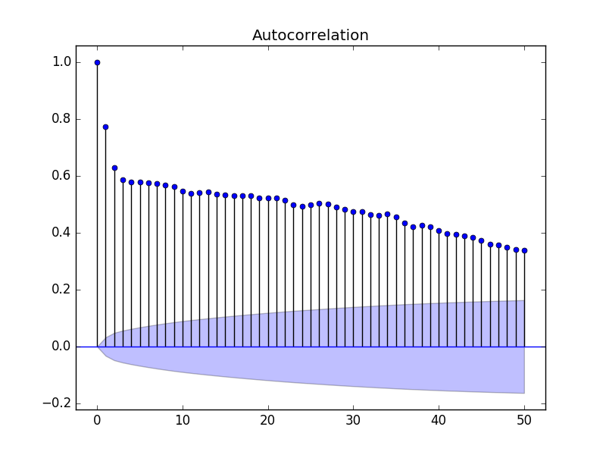
Time Series – ACF and PACF
Autocorrelation
Cone of 95% confidence
Lagged values with correlation coef. outside this cone can be used for MA

Slide 50
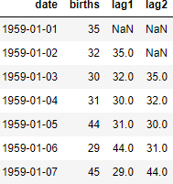
Time Series – ACF and PACF
Lag 1 Lag 2
Lag 1 –Lag 2
Partial Autocorrelation
Correlation
Coef = 0.8
Correlation
Coef = 0.6
Correlation
Coef = 0.8

Slide 51
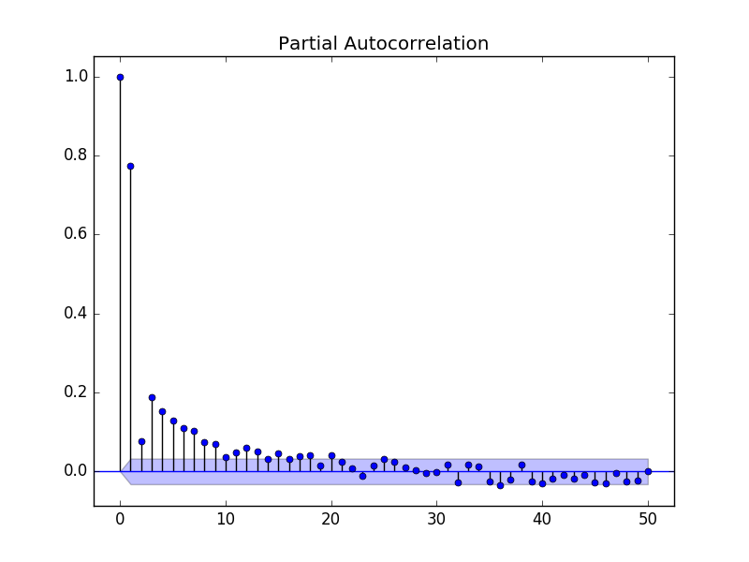
Time Series – ACF and PACF
Partial Autocorrelation
Lagged values with correlation coef. outside this cone can be used for
Autoregression

Slide 52
Time Series – ARIMA
Step 1
Use differencing to remove trend and seasonality
Step 2
Use AR to do forecasting
Step 3
Use MA on residuals to update the forecast
Step 4
Add Trend and Seasonality to get the forecasted value
ARIMA

Slide 53
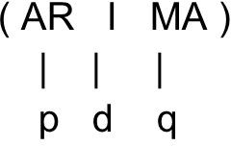
Time Series – ARIMA
P – Order of autoregression
how many lag variables to choose
D – Order of Integration
Number of differencing needed
Q – Order of Moving Average
What is the window size for Moving Average
Parameter
Stamatics

